Slide 1
3D Space-Time Correspondence from Normal-assisted Random Walk
Changyuan Qiu, Zhuowen Shen, Yuliang Zhu, Linyi Jin

Slide 2
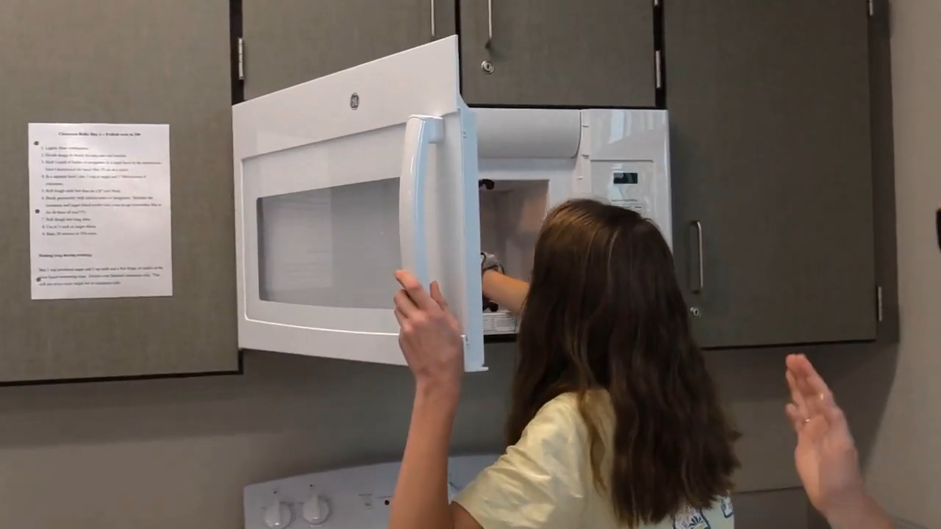
Motivation

Slide 3
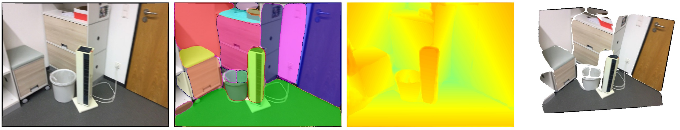
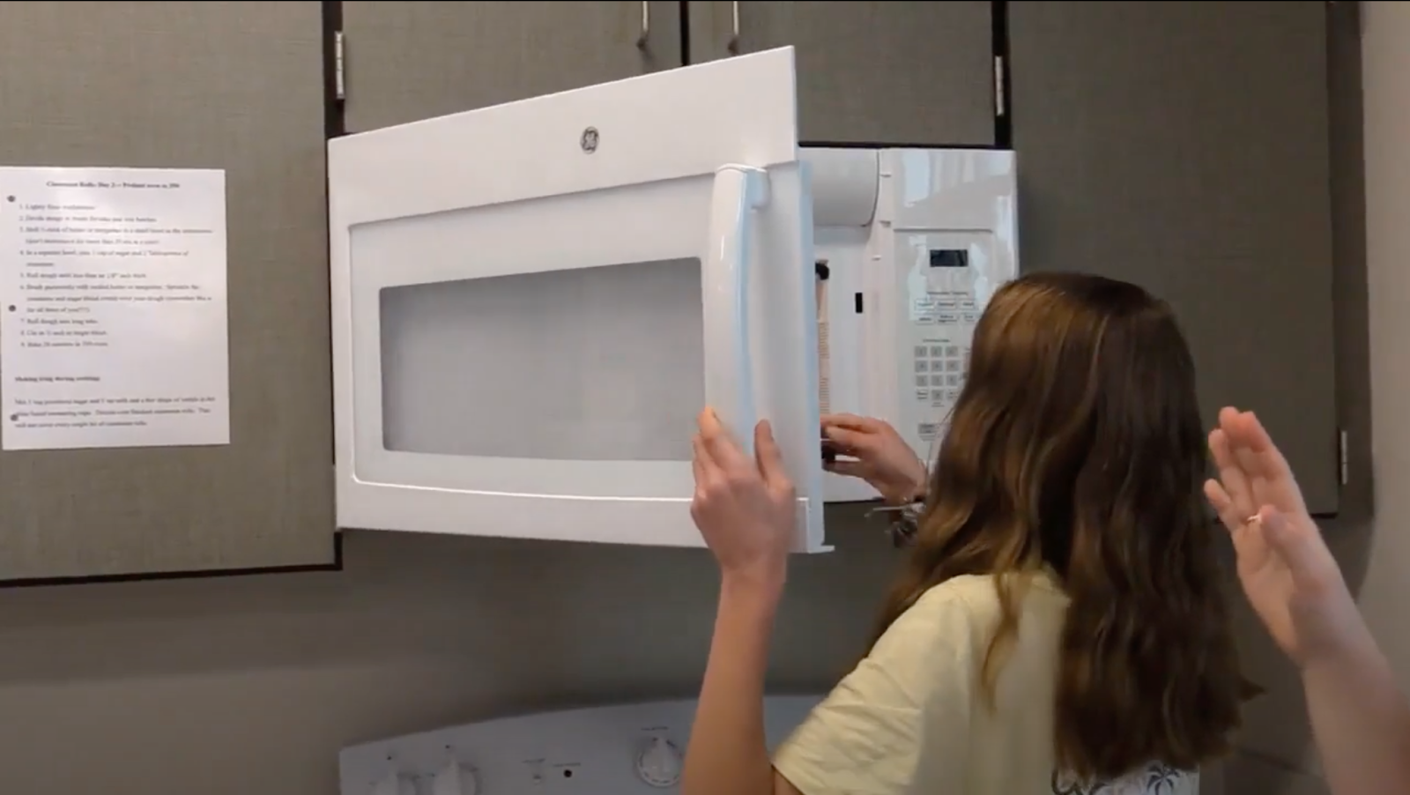
Motivation
Liu et. al. PlaneRCNN: 3D Plane Detection and Reconstruction from a Single Image. CVPR 2019

Slide 4
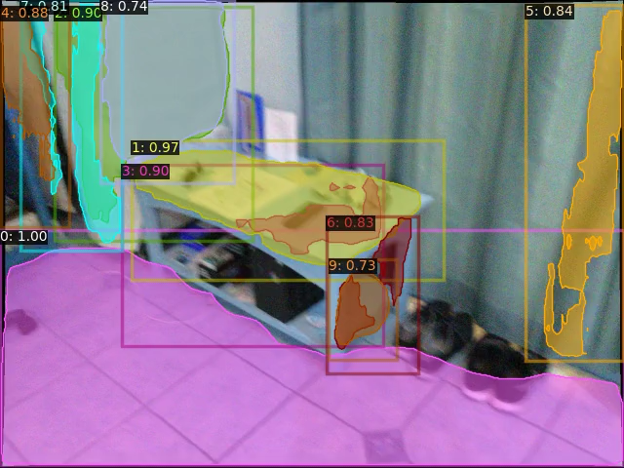
Motivation
-- No correspondence between frames
-- Plane normal may not be consistent
-- GT correspondences are expensive to label

Slide 5
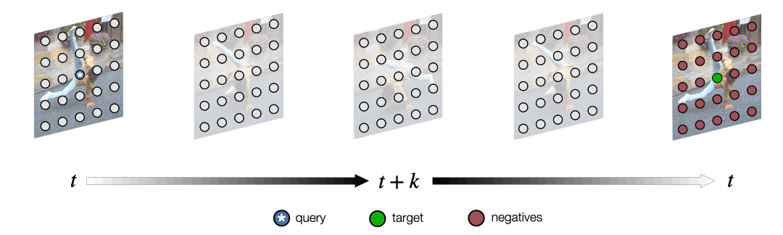
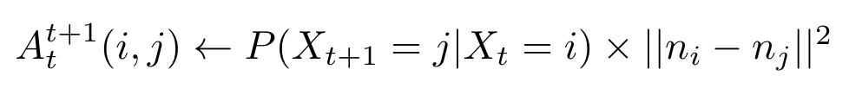
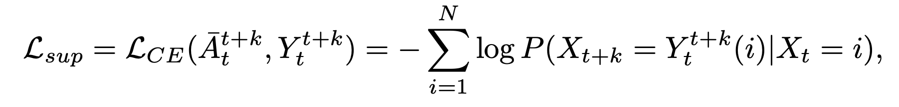
Approach
“normal-assisted” random-walk
Assign each patch a normal using Generalized IoU (Rezatofighi et al. CVPR2019)
Allan Jabri, Andrew Owens, Alexei A. Efros. Space-Time Correspondence as a Contrastive Random Walk. NeurIPS 2020

Slide 6
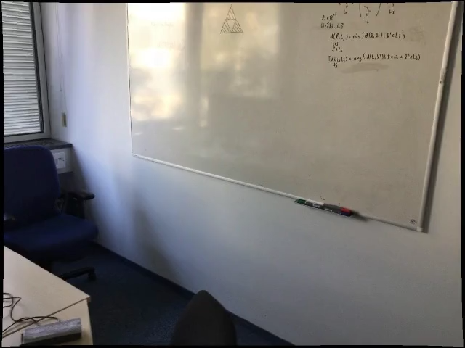
Dataset
Training on ScanNet videos
With annotated planes but this is a static dataset.
Ideally we need a dataset with dynamic scenes.

Slide 7
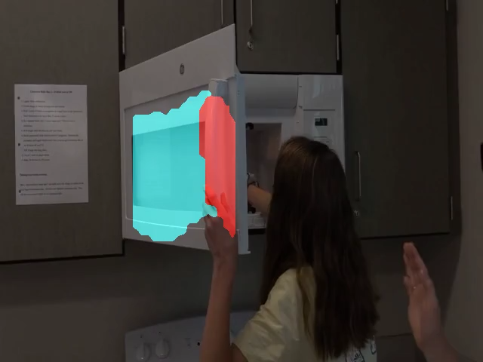

Results
Kinetics400 (Original Model)
Trained on one video in ScanNet

Slide 8

One video in ScanNet
w/o normal guidance
One video in ScanNet
w/ normal guidance

